Slide 1
Preparing to Train
Module 4

Slide 2
Module Objective
At the end of this module, you will be able to identify the requirements to present training
Module Objective
At the end of this module, you will be able to identify the requirements to present training.

Slide 3
Discussion Question
Why is preparation important?
Discussion Question
Why is preparation important?

Slide 4

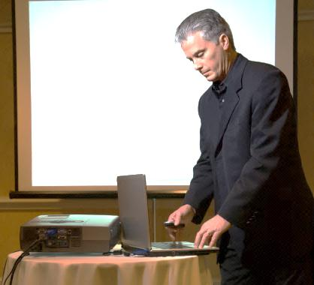
Prepare the Logistics
Refer To:
Workbook 4.1
Training Facilities
  Layout
  Power
  Safety and Security
Materials, Supplies, and Equipment
Logistical Support
  Transportation
  Food and Lodging
Source: DS/T/ATA
Prepare the Logistics
Refer To:
Workbook 4.1
Training Facilities
  Layout
  Power
  Safety and Security
Materials, Supplies, and Equipment
Logistical Support
  Transportation
  Food and Lodging

Slide 5

Setting Up Training Equipment
Test all equipment
Have a backup plan
Preview all media fully
Become proficient in new technology before using it
Source: Getty
Setting Up Training Equipment
Goal = No Surprises
Test all equipment
Have a backup plan
Preview all media fully
Become proficient in new technology before using it
Goal = No Surprises

Slide 6

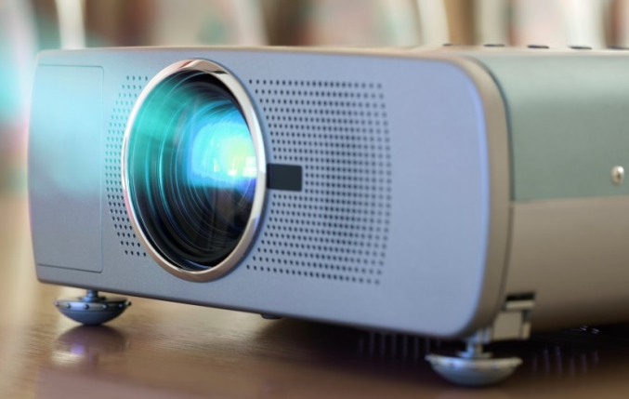

Using Classroom Equipment
Refer To:
Workbook 4.2
Source: Getty
Source: Getty
Using Classroom Equipment
Refer To:
Workbook 4.2

Slide 7
Specific Advice and Direction
Course Facilities and Equipment
  Review of requirements
  Specific steps and timeline for setting up facilities and equipment for the course
Tips
  Advice on setting up the equipment and facilities
  Common problems encountered and solutions
  Demonstration of selected techniques
Specific Advice and Direction
Course Facilities and Equipment
  Review of requirements
  Specific steps and timeline for setting up facilities and equipment for the course
Tips
  Advice on setting up the equipment and facilities
  Common problems encountered and solutions
  Demonstration of selected techniques

Slide 8
Setting Up Facilities and Equipment Activity
Refer To:
Workbook 4.3
Purpose: to practice setting up training facilities and equipment
  Duration: 20 minutes (10-preparation; 10- debrief) Group: Small group
  Debrief: Large group discussion
Setting Up Facilities
and Equipment Activity
Refer To:
Workbook 4.3
Purpose: to practice setting up training facilities and equipment
  Duration 20 minutes (10-preparation; 10- debrief) Group: Small group
  Debrief: Large group discussion

Slide 9

Prepare the Content: Overview
Learning the Content
Using Course Materials
Customizing Content
  Developing Notes
  Anticipating Needs and Interests
Preparing Activities
Source: Getty
Prepare the Content: Overview
Learning the Content
Using Course Materials
Customizing Content
  Developing Notes
  Anticipating Needs and Interests
Preparing Activities

Slide 10
Discussion Question
What is the consequence of failing to learn the content prior to conducting the training?
Discussion Question
What is the consequence of failing to learn the content prior to conducting the training?

Slide 11
Learning the Content
Step 1 – The Outcomes
Step 3 – The Details
Step 4 – The Test
Step 2 – The Big Picture
Identify importance of objectives and content
Scan the entire module
Read and make your own notes
Close the module and list the major topics
Learning the Content
Step 1 – The Outcomes
Step 3 – The Details
Step 4 – The Test
Step 2 – The Big Picture
Identify importance of objectives and content
Scan the entire module
Read and make your own notes
Close the module and list the major topics
Learning the Content

Slide 12
Using the Materials
Do
  Use the notes to prepare
  Summarize the key points from the slides
Do not
  Use the notes as a script
  Read from the notes while teaching
  Read the slides verbatim to the class
Using the Materials
Do
  Use the notes to prepare
  Summarize the key points from the slides
Do not
  Use the notes as a script
  Read from the notes while teaching
  Read the slides verbatim to the class

Slide 13

Customizing the Content
Note recent examples
Identify relevant personal experiences
Prepare descriptions of how the training applies to the job
Source: Getty
Ensuring the proper fit
Customizing the Content
Note recent examples
Identify relevant personal experiences
Prepare descriptions of how the training applies to the job
Ensuring the proper fit

Slide 14
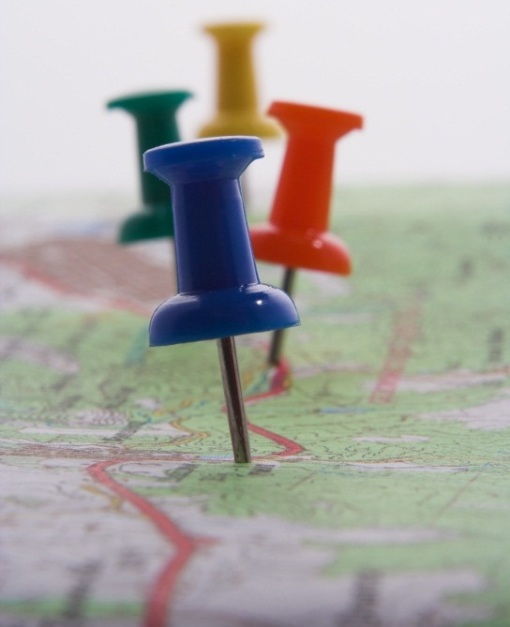
Developing Facilitator Notes
Provides
  Roadmap for preparing a training session
  Plan for achieving the learning objectives
Includes
  Key content
  Examples
  Discussion questions
  Sample answers
Source: Getty
Developing Facilitator Notes
Provides
  Roadmap for preparing a training session
  Plan for achieving the learning objectives
Includes
  Key content
  Examples
  Discussion questions
  Sample answers

Slide 15

Anticipate Interests and Needs
Highlight topics of special interest
Note areas that require detailed instruction
List potential participant questions and answers
Source: Getty
Being prepared
Anticipate Interests and Needs
Highlight topics of special interest
Note areas that require detailed instruction
List potential participant questions and answers
Being prepared

Slide 16

Preparing Learning Activities
Practice providing instructions and completing the activity
Anticipate logistical, safety, and security needs
Source: Getty
Having a game plan
Preparing Learning Activities
Practice providing instructions and completing the activity
Anticipate logistical, safety, and security needs
Having a game plan

Slide 17

Preparing to
Present a Module Activity
Workbook 4.4
Handout 3.1
Purpose: to prepare to present a specific module
  Duration: 50 minutes (30-preparation; 20-discussion)
  Group: Participant pairs
  Debrief: Large group discussion
Preparing to
Present a Module Activity
Refer To:
Workbook 4.4
Handout 3.1
Purpose: to prepare to present a specific module
  Duration 50 minutes (30-preparation; 20-discussion)
  Group: Participant pairs
  Debrief: Large group discussion

Slide 18
Prepare for Classroom Management
Beginning Each Day
Managing Time
Managing Breaks
Managing Challenging Participants
Assessing Learning
Prepare for Classroom Management
Beginning Each Day
Managing Time
Managing Breaks
Managing Challenging Participants
Assessing Learning

Slide 19
Discussion Question
What is a consequence of failing to manage the classroom?
Discussion Question
What is a consequence of failing to manage the classroom?

Slide 20

Beginning Training Each Day
Arrive early to
  Prepare the classroom
  Check equipment
  Prepare charts and displays
  Distribute materials
Be ready to greet participants
Beginning Training Each Day
Arrive early to
  Prepare the classroom
  Check equipment
  Prepare charts and displays
  Distribute materials
Be ready to greet participants
Source: Getty

Slide 21
Discussion Questions
What are examples of things that waste time within a training session?
Discussion Questions
What are examples of things that waste time within a training session?

Slide 22

Managing Training Time
Develop a detailed time plan
Track actual time used
Use a clock to monitor time
Deal with disruptive events and participants
Organize the classroom
Manage breaks
Managing Training Time
Develop a detailed time plan
Track actual time used
Use a clock to monitor time
Deal with disruptive events and participants
Organize the classroom
Manage breaks
Source: Getty

Slide 23

Discussion Question
How do you know when it is time to take a break?
Discussion Question
How do you know when it is time to take a break?
Source: Getty

Slide 24

Managing Breaks
Use breaks to
  Re-energize participants
  Gather your thoughts
  Transition from one topic to the next
Enforce break time limits
Model being prompt
Managing Breaks
Use breaks to
  Re-energize participants
  Gather your thoughts
  Transition from one topic to the next
Enforce break time limits
Model being prompt
Source: Getty

Slide 25
Managing Challenging Participants
Prevent problems by establishing relationships
Take action before others get frustrated by
  Determining the potential reasons for the behaviors
  Talking to the individual privately
  Taking actions that are fair
Managing Challenging Participants
Prevent problems by establishing relationships
Take action before others get frustrated by
  Determining the potential reasons for the behaviors
  Talking to the individual privately
  Taking actions that are fair

Slide 26
Managing Challenging Participants Activity
Refer To:
Workbook 4.5
Purpose: to identify strategies for managing challenging participants
  Duration: 15 minutes (5-preparation; 10-discussion)
  Group: Individual
  Debrief: Large group discussion
Managing Challenging Participants Activity
Refer To:
Workbook 4.5
Purpose: to identify strategies for managing challenging participants
  Duration 15 minutes (5-prepartion; 10-discussion)
  Group: Individual
  Debrief: Large group discussion

Slide 27
Assessing Learning
Observe Participant Reactions
Review Exercise Results
Ask Questions
Have Participants Teach Back
Source: Getty
Source: Getty
Source: Getty
Source: Getty
Assessing Learning
Observe Participant Reactions
Review Exercise Results
Ask Questions
Have Participants Teach Back
Assessing Learning

Slide 28
Making Midcourse Assessments
Collect continuous feedback
Check that corrections will allow participants to achieve all objectives
Making Midcourse Assessments
Collect continuous feedback
Check that corrections will allow participants to achieve all objectives

Slide 29
Using Evaluation Results
Training Goals: What did we set out to do?
Training Outcomes: What actually happened?
Improvements: What are we going to do better next time?
Follow-Up Actions: What follow-up actions are needed?
Using Evaluation Results
Training Goals: What did we set out to do?
Training Outcomes: What actually happened?
Improvements: What are we going to do better next time?
Follow-Up Actions: What follow-up actions are needed?

Slide 30

Key to Preparation: Practice
Knowing your subject builds confidence
Practicing enables you to communicate that knowledge
Source: Getty
Key to Preparation: Practice
Knowing your subject builds confidence
Practicing enables you to communicate that knowledge

Slide 31
Module Summary
Prepare the logistics
Prepare the content
Prepare for classroom management
Module Summary
Prepare the logistics
Prepare the content
Prepare for classroom management

