Slide 1
Facilitating Training
Module 3

Slide 2
Module Objective
At the end of this module, you will be able to facilitate a five-minute training session
Module Objective
At the end of this module, you will be able to facilitate a 5 minute training session.

Slide 3
Discussion Question
What are the characteristics of effective presenters?
Discussion Question
What are the characteristics of effective presenters?

Slide 4


Effective Presenters Are Communicators
Verbal and
Nonverbal
Messages
Feedback
Source: Getty
Source: Getty
Sender
Receiver
Knowledge Transfer and Learning
Effective Presenters Are Communicators
Verbal and Nonverbal
Messages
Feedback
Sender
Receiver
Knowledge Transfer and Learning

Slide 5

Presentation Skills:
Nonverbal Communication
Source: Getty
Presentation Skills:
Nonverbal Communication

Slide 6

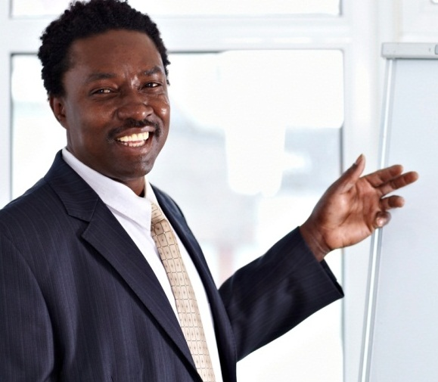
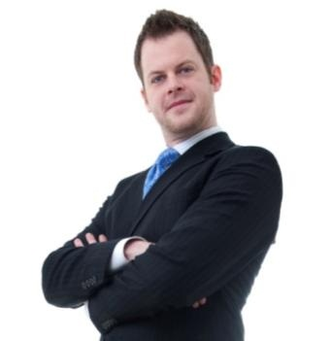
What Is the Nonverbal Message?
Source: Getty
Source: Getty
Source: Getty
A
B
C
What Is the Nonverbal Message?
A
B
C

Slide 7
Nonverbal Communication as a Facilitator
Communicate your confidence and expertise
Express your enthusiasm
Show you are willing to answer questions
Indicate support of the course participants
Nonverbal Communication as a Facilitator
Communicate your confidence and expertise
Express your enthusiasm
Show you are willing to answer questions
Indicate support of the course participants

Slide 8


Example of Nonverbal
Communication as a Facilitator
Posture and energy level
  Demonstrates respect
  Indicates boredom or enthusiasm
Example of Nonverbal
Communication as a Facilitator
Posture and energy level
  Demonstrates respect
  Indicates boredom or enthusiasm
Source: Getty

Slide 9


Examples of Nonverbal
Communication as a Facilitator (2 of 2)
Examples of Nonverbal
Communication as a Facilitator (2 of 2)

Slide 10
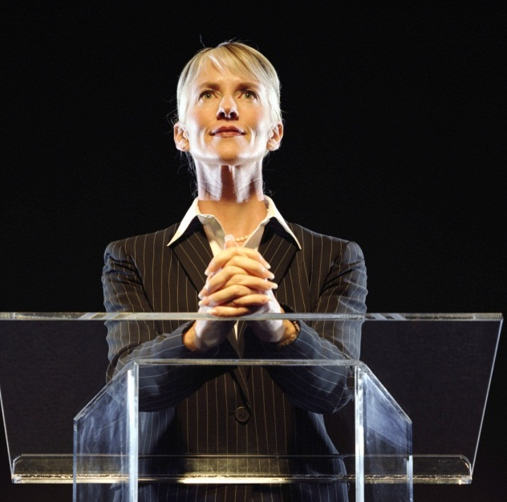

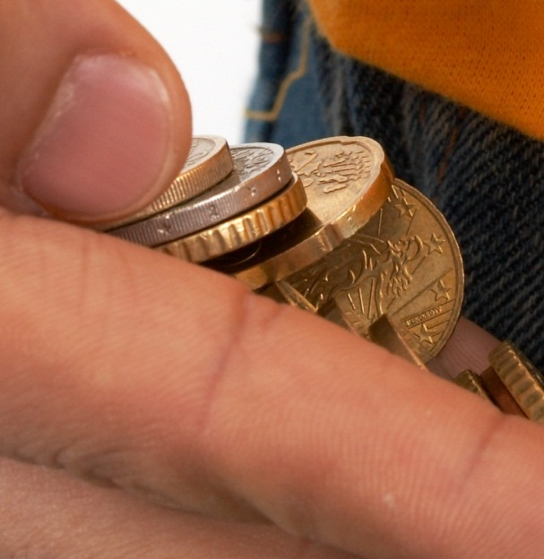
Things to Avoid for
Nonverbal Communication
Source: Getty
Source: Getty
Source: Getty
Rigid Stance
Nervous Habits
Distracting Behaviors
Things to Avoid for Nonverbal Communication
Rigid
Stance
Nervous
Habits
Distracting
Behaviors

Slide 11
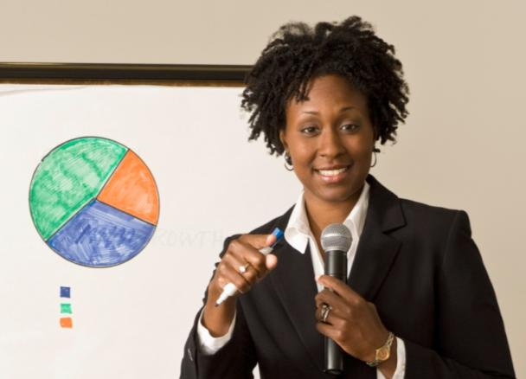
Presentation Skills: Verbal Communication
Source: Getty
Presentation Skills: Verbal Communication

Slide 12
Elements of Verbal Communication
Be clear and precise
Use your voice
Vary the pitch
Elements of Verbal Communication
Be clear and precise
Use your voice
Vary the pitch

Slide 13
Be Clear and Precise
Choose familiar, simple words
Use phrases that create images
Keep sentences brief
Organize your thoughts – think before you speak
Be Clear and Precise
Choose familiar, simple words
Use phrases that create images
Keep sentences brief
Organize your thoughts – think before you speak

Slide 14

Use Your Voice
Speak loud enough to be heard
Control the pace of your presentation
Slow down for important parts
Use pauses
Do not talk over noise or side conversations
Use Your Voice
Speak loud enough to be heard
Control the pace of your presentation
Slow down for important parts
Use pauses
Do not talk over noise or side conversations
Source: Getty

Slide 15

Vary the Pitch
Which sound keeps your interest?
A
B
Monotone: One pitch
  Very mechanical sounding
Intonation: More than one pitch
  Subtle changes keep listeners engaged
Vary the Pitch
Which sound keeps your interest?
Monotone: One pitch
  Very mechanical sounding
Intonation: More than one pitch
  Subtle changes keep listeners engaged

Slide 16

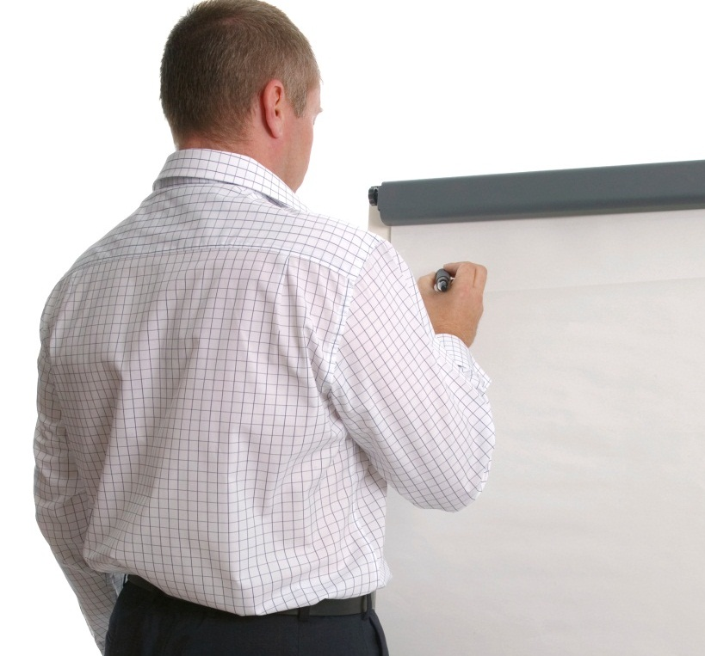
Things to Avoid for Verbal Communication
Source: Getty
Source: Getty
Reading
Long Passages
Speaking With Your Back to the Class
Things to Avoid for Verbal Communication
Reading Long Passages
Speaking With Your Back to the Class

Slide 17

TeachBack
What nonverbal methods do facilitators use to communicate?
What are the elements of verbal communications?
TeachBack
What nonverbal methods do facilitators use to communicate?
What are the elements of verbal communications?

Slide 18
Facilitation
Facilitation

Slide 19


Introduction
Presentation Activity
Workbook 3.1
Handout 3.1 and Facilitator Guide
Purpose: to present an introduction for training
  Duration: 25 minutes (15-preparation;3-presentation; 7-discussion)
  Group: Individual
  Debrief: Self-assessment and large group discussion
Introduction
Presentation Activity
Refer To:
Workbook 3.1
Handout 3.1 and Facilitator Guide
Purpose: to present an introduction for training
  Duration 25 minutes (15-preparation;3-presentation; 7-discussion)
  Group: Individual
  Debrief: Self-assessment and large group discussion

Slide 20
Discussion Question
What is the difference between presentation and facilitation?
Provide an example of when facilitation is not appropriate
Discussion Question
What is the difference between presentation and facilitation?
Provide an example of when facilitation is not appropriate.

Slide 21
Facilitation
Get everyone involved by
  Observing
  Asking questions
  Acknowledging responses
  Conducting learning activities
Facilitation
Get everyone involved by
  Observing
  Asking questions
  Acknowledging responses
  Conducting learning activities

Slide 22
Discussion Question
What can you learn from observing course participants?
Discussion Question
What can you learn from observing course participants?

Slide 23

Asking Questions
Questions should
  Be clear
  Be simple and concise
  Focus on a single issue
  Not require more than one answer
Source: Getty
Asking Questions
Questions should
  Be clear
  Be simple and concise
  Focus on a single issue

Slide 24
Using Questions for Learning
Step 1: Ask the question
Step 2: Wait for the class to respond
Step 3: If no one answers, rephrase the question
Important: Avoid answering your own question
Using Questions for Learning
Step 1: Ask the question
Step 2: Wait for the class to respond
Step 3: If no one answers, rephrase the question
Important: Avoid answering your own question

Slide 25
Types of Questions
Open questions
Closed questions
Types of Questions
Open questions
Closed questions

Slide 26
Writing Questions Activity
Refer To:
Workbook 3.2
Purpose: to write open and closed questions to conduct training
  Duration: 10 minutes (5-preparation; 5-discussion)
  Group: Individual or as small groups
  Debrief: Large group discussion
Writing Questions Activity
Refer To:
Workbook 3.2
Purpose: to write open and closed questions to conduct training
  Duration 10 minutes (5-preparation; 5- discussion)
  Group: Individual or as small groups
  Debrief: Large group discussion

Slide 27

Acknowledging Responses (1 of 6)
Listening requires effort to hear and understand what people are saying
Source: Getty
Acknowledging Responses (1 of 4)
Listening requires effort to hear and understand what people are saying

Slide 28
Acknowledging Responses (2 of 6)
Listening tips:
  Keep an open mind
  Maintain eye contact
  Consider the speaker’s nonverbal and verbal communication
Acknowledging Responses (2 of 4)
Listening tips:
  Keep an open mind
  Maintain eye contact
  Consider the speaker’s nonverbal and verbal communication

Slide 29
Discussion Question
Why do people fail to listen?
Discussion Question
Why do people fail to listen?

Slide 30
Acknowledging Responses (3 of 6)
Respond by:
  Summarizing in your own words what you heard and observed
  Demonstrating that you listened
  Reinforcing participation
Acknowledging Responses (3 of 4)
Summarize what you heard and observed in your own words
Respond by:
  Providing positive, constructive feedback
  Praising correct performance
  Avoid being judgmental
  Correcting inaccurate statements

Slide 31
Acknowledging Responses (4 of 6)
Responding to participant answers by:
  Providing positive, constructive feedback
  Praising correct performance
  Not being judgmental
  Correcting inaccurate statements
Acknowledging Responses (4 of 6)
Responding to participant answers by:
  Providing positive, constructive feedback
  Praising correct performance
  Not being judgmental
  Correcting inaccurate statements

Slide 32
Acknowledging Responses (5 of 6)
If the response is unclear
  Ask clarifying questions
  Allow the participant to clarify
If the response is incorrect
  Use additional questions to provide coaching
  Reinforce and build on correct aspects
  Allow other participants to help
Acknowledging Responses (5 of 6)
If the response is unclear
  Ask clarifying questions
  Allow the participant to clarify
If the response is incorrect
  Use additional questions to provide coaching
  Reinforce and build on correct aspects
  Allow other participants to help

Slide 33
Acknowledging Responses (6 of 6)
Answering questions
  Repeat the question
  Answer the question
  Defer the question
Acknowledging Responses (6 of 6)
Answering questions
  Repeat the question
  Answer the question
  Defer the question

Slide 34
Discussion Question
What would you do if the participants:
  Incorrectly answer a question you asked?
  Does not respond to a question you asked?
  Ask you a question the class should be able to answer?
What would you do if only a few participants are answering questions?
Discussion Question
What would you do if the participants:
  Answer the question incorrectly?
  Does not respond to a question?
What would you do if only a few participants are answering questions?

Slide 35
Conducting Learning Activities
Step 1: Present the purpose of the activity
Step 2: Explain the instructions clearly and simply
Step 3: Check for understanding and monitor progress
Step 4: Discuss the results and provide feedback
Conducting Learning Activities
Step 1: Present the purpose of the activity
Step 2: Explain the instructions clearly and simply
Step 3: Check for understanding and monitor progress
Step 4: Discuss the results and provide feedback

Slide 36
Providing Feedback
Use positive, useful words when providing feedback
Avoid embarrassing the course participant
Determine the cause of any learning problems and provide coaching
Providing Feedback
Use positive words
Avoid embarrassing the participant
Determine the cause of any learning problems and provide additional guidance

Slide 37
Barriers to Learning
Lack of Motivation
Inadequate Resources
Insufficient Knowledge or Skills
Poor Instruction
Source: Getty
Source: Getty
Source: Getty
Source: Getty
Barriers to Learning
Lack of Motivation
Inadequate Resources
Insufficient Knowledge or Skills
Poor Instruction

Slide 38
Facilitation Presentation Activity
Workbook 3.1
Handout 3.1 and Facilitator Guide
Purpose: to facilitate training
  Duration: 30 minutes (20-preparation;10-presentation and discussion)
  Group: Individual
  Debrief: Large group discussion
Facilitation
Presentation Activity
Refer To:
Workbook 3.1
Handout 3.1 and Facilitator Guide
Purpose: to facilitate training
  Duration 30 minutes (20-preparation;10-presentation and discussion)
  Group: Individual
  Debrief: Large group discussion

Slide 39
Module Summary
Communication
Facilitation
Module Summary
Communication
Facilitation

