Slide 1
Adult Learning Principles
Module 2

Slide 2
Module Objective
At the end of this module, you will be able to determine the target audience requirements based on adult learning principles.
Module Objective
At the end of this module, you will be able to determine the target audience requirements based on adult learning principles.

Slide 3
Adult Learner Characteristics
Motivations and readiness
Previous learning
Active learning
Adult Learner Characteristics
Motivations and readiness
Previous learning
Active learning

Slide 4
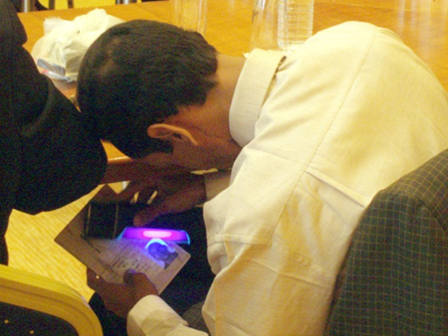
Adult Learners:
Motivations and Readiness
Adults learn more when training:
  Relates to a personal need or benefit
  Explains the reason why
  Focuses on job-related or practical situations
  Helps them succeed
Source: DS/T/ATA
Adult Learners: Motivations and Readiness
Adults learn more when training:
  Relates to a personal need or benefit
  Explains the reason why
  Focuses on job-related or practical situations
  Helps them succeed

Slide 5
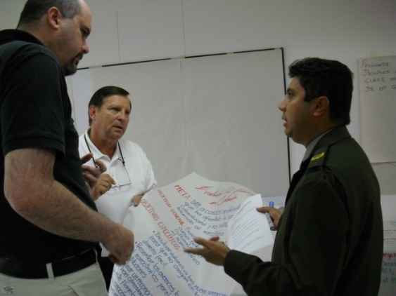
Adult Learners: Previous Learning
Adults learn by
  Associating new learning to past experiences to create their own understanding
  Recognizing the need to change previous assumptions, procedures, or techniques
Adult Learners: Previous Learning
Adults learn by
  Associating new learning to past experiences to create their own understanding
  Recognizing the need to change previous assumptions, procedures, or techniques
Source: DS/T/ATA

Slide 6
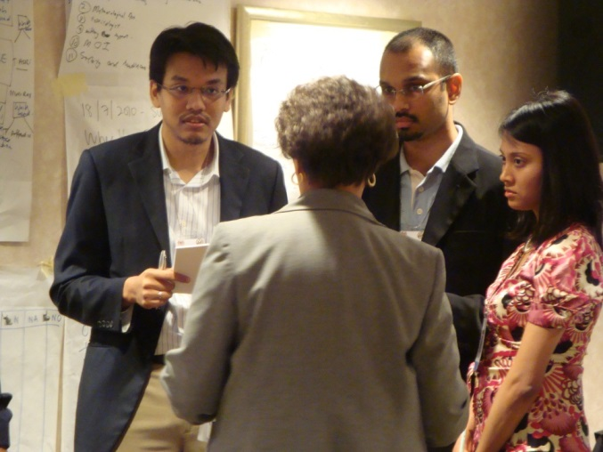

Adult Learners: Active Learning
Adults learn and remember more when the training is active rather than passive
Source: DS/T/ATA
Source: Getty
Adult Learners: Active Learning
Active
Passive
Active
Passive

Slide 7

Adult Learning
Principles Activity
Refer To:
Workbook 2.1
Purpose: to describe adult learning principles
  Duration 45 minutes (15-preparation; 30-presentation and debrief)
  Group: Small group
  Debrief: Large group discussion
Adult Learning
Principles Activity
Refer To:
Workbook 2.1
Purpose: to describe adult learning principles
  Duration 45 minutes (15-prepartion; 30-presentation and debrief)
  Group: Small group
  Debrief: Large group discussion

Slide 8



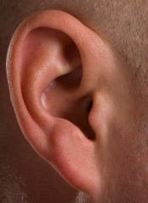


Multiple Learning Channels
Source: Getty
Source: Getty
Source: Getty
Hearing
Seeing
Touching/Doing
Multiple Learning Channels
Hearing
Seeing
Touching/Doing

Slide 9
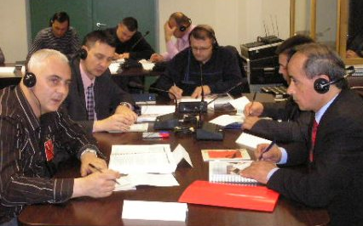
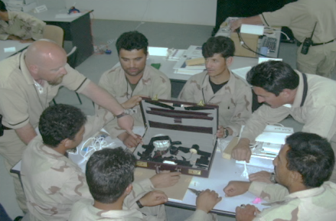
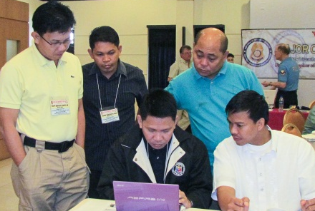
Formula for Learning
=
Learning
+
+
Source: DS/T/ATA
Source: DS/T/ATA
Source: DS/T/ATA
Telling
Showing
Doing
Formula for Learning
Learning
Telling
Showing
Doing

Slide 10

TeachBack
Explain multiple learning channels
TeachBack
Explain multiple learning channels

Slide 11
Analyze Your Audience (1 of 2)
Who needs to receive training?
What are their current skill and knowledge levels?
Analyze Your Audience (1 of 2)
Who needs to receive training?
What are their current skill and knowledge levels?

Slide 12
Analyze Your Audience (2 of 2)
What are their preferred learning channels?
What is their motivation level?
Analyze Your Audience (2 of 2)
What are their preferred learning channels?
What is their motivation level?

Slide 13

Target Audience
Analysis Activity
Refer To:
Workbook 2.2
Purpose: to determine the target audience who will attend the training course
  Duration 25 minutes (15-preparation; 10-discussions)
  Group: Individual
  Debrief: Large group discussion
Target Audience
Analysis Activity
Refer To:
Workbook 2.2
Purpose: to determine the target audience who will attend the training course the participants will be presenting when they return to their countries
  Duration 25 minutes (15-prepartion; 10-discussions)
  Group: Individual
  Debrief: Large group discussion

Slide 14
Module Summary
Adult learning principles
Multiple learning channels
Target audience analysis
Module Summary
Adult learning principles
Multiple learning channels
Target audience analysis

