Slide 1
Introduction
Module 1

Slide 2
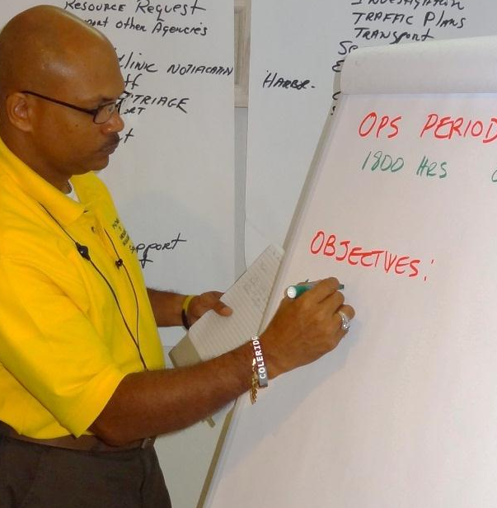
Course Purpose
To provide participants an opportunity to:
  Enhance their facilitation skills
  Practice using the course materials
Source: DS/T/ATA
Course Purpose
To provide participants an opportunity to:
  Enhance their facilitation skills
  Practice using the course materials

Slide 3

Thinking about Learning Activity
Refer To:
Workbook 1.1
Purpose: to explore different points of view about teaching and learning
  Duration: 20 minutes (10-preparation;10-debrief)
  Group: Small group
  Debrief: Large group
Thinking About
Learning Activity
Refer To:
Workbook 1.1
Purpose: to identify the qualities of effective training courses by reflecting on the training just completed
  Duration 20 minutes (10-prepartion;10-debrief)
  Group: Small group
  Debrief: Large group

Slide 4
Education and Training
Education: General knowledge and skills
Training: Job-specific knowledge and skills
Education and Training
Education: General knowledge and skills
Training: Job-specific knowledge and skills

Slide 5
Training Description
Adult Learning Principles
Skills Building
Lessons Learned
Practice Presentations
Training Description
Adult Learning Principles
Skills Building
Lessons Learned
Practice Presentations

Slide 6
Participant Expectations
Be open to new ideas
Participate in all activities
Be willing to listen to feedback
Do your best
Participant Expectations
Be open to new ideas
Participate in all activities
Be willing to listen to feedback
Do your best

Slide 7
Course Schedule
Refer To:
Workbook 1.2
Day | Milestones
1 | Adult Learning Principles; Facilitator Training
2 | Preparing to Train
3 | Capstone
Course Schedule
Refer To:
Workbook 1.2
Day | Milestones
1 | Adult Learning Principles; Facilitator Training
2 | Preparing to Train
3 | Capstone

Slide 8
Course Materials
Train-the-Trainer Course
  Workbook
ATA Course Material
  Workbook
  Materials on disc
Course Materials
Train-the-Trainer Course
  Participant Guide and Addenda
  Glossary
ATA Course Material
  Guides and Slides
  Materials Disc

Slide 9
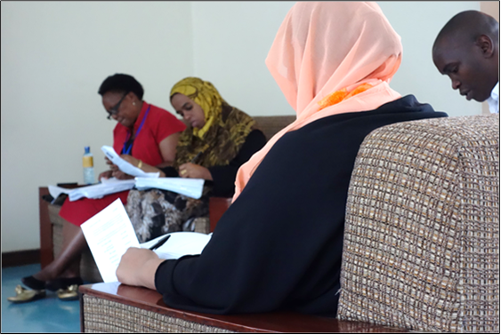
Instructional Strategies
Presentation
Discussion
Practical exercises
Source: DS/T/ATA
Instructional Strategies
Presentation
Discussion
Practical exercises

Slide 10
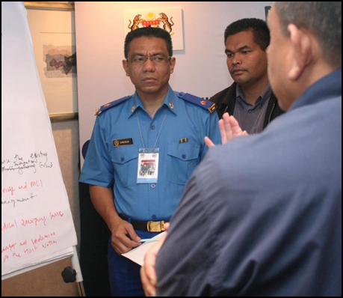
Course Logistics
Class representative
Daily schedule
Important events
Source: DS/T/ATA
Course Logistics
Class representative
Daily schedule
Important events

Slide 11
Module Summary
Overall purpose of Train-the-Trainer
Differences between education and training
Participant expectations
Schedule and materials
Module Summary
Overall purpose of Train-the-Trainer
Differences between education and training
Participant expectations
Schedule and materials

